Slide 1
ENSE 470, Milestone 1
Tiger Vikings
Samuel Iregbu, Christian John, Jay Denesik, Uys Kriek
January 18th, 2018

Slide 2
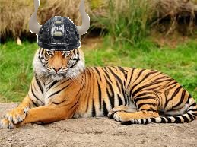
Team Introductions:
Samuel Iregbu, Christian John, Jay Denesik, Uys Kriek

Slide 3
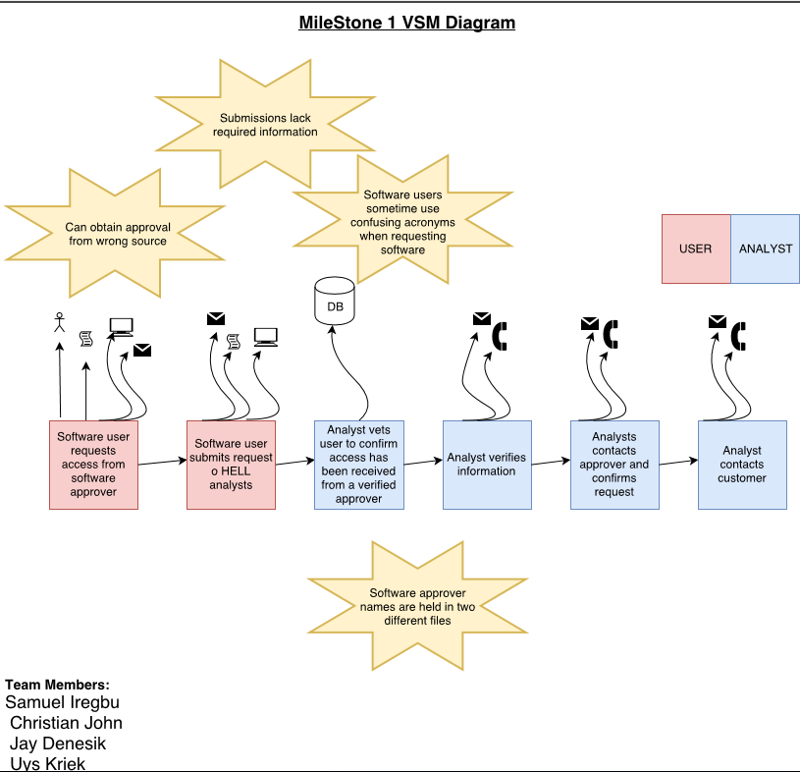

Slide 4
Group Reflection:
How did you feel about this milestone? What did you like about it? What did you dislike?
Good beginning milestone. Outlined the problems and helped us to better understand the project. We liked that lab time was given.
What did you learn about yourself as you collaborated and worked through this milestone?
We learned how to work as a team
How will you use what you have learned going forward?
We will now be able to use VSM on any problems going forward
What “stuff & things” related to this milestone would you want help with?
More clearly outlined VSM requirements

